Slide 1

PROJECT PRESENTATION ON E-Commerce Marketplace Platform Development Submitted for the partial fulfilment of the requirement for the degree of Bachelor of Engineering Dibrugarh University Session 2019-20
Under the Guidance of
Diganta Baishya,
Assistant Professor,
Jorhat Engineering College
as per the Industry-Institute collaboration with
Dithok Technologies LLP
Submitted By:
Anupal Neog(CS-15/16)
Raja Shah(CS-40/16)
Shekhar Dhar(CS-42/16)
James Lalringsan(CS-52/16)

Slide 2
Objective
Building a platform compatible for setting up a fully functional E-commerce Business.
with Customer relationship management(CRM) facilities
Building an E-commerce Mobile App integrated with this platform.

Slide 3
Technologies Used
FrontEnd Development
Mobile App - Flutter
Web CRM - AngularJS
BackEnd Development- Java Spring Boot
Database Management System - MySQL
REST Api
Version Control Platform - Github
Testing
FrontEnd: Mokito
BackEnd : Postman
Build automation system - gradle

Slide 4
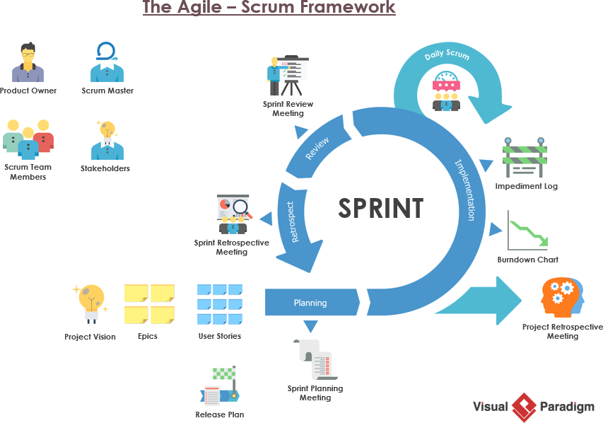
Software Development Methodology

Slide 5
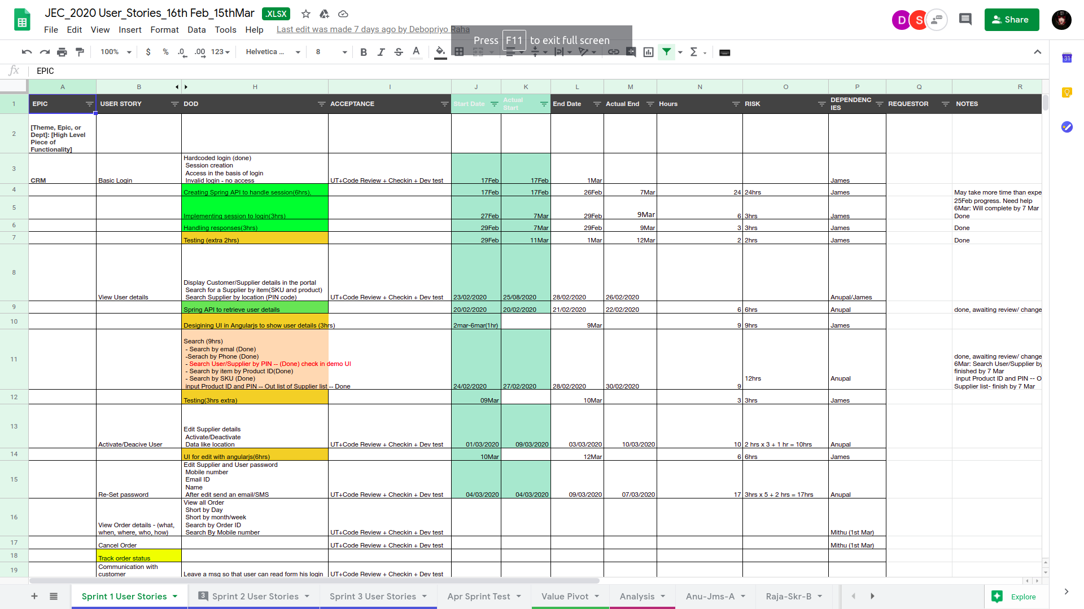

Slide 6
DEMO

Slide 7
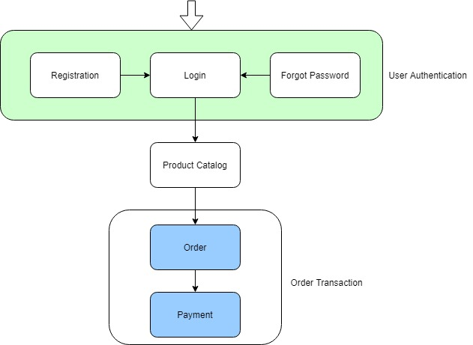

Slide 8
